Slide 1


Myntra Customer Analysis
ANALYTICAL INSIGHTS & FASHION MARKETPLACE DYNAMICS
5BN
172.85
184M
1.77
SUM OF IDS
AVG. DISCOUNT
SUM OF PRICE
AVG. RATING

Slide 2

The dashboard signals scale, price depth, and a discount-led marketplace.
VOLUME & SCALE
5BN
PRICING DEPTH
184M
A high Sum of ID suggests a massive marketplace reach, requiring robust infrastructure to manage millions of product interactions and customer data points.
The 184M Sum of Price indicates a significant total inventory value, reflecting Myntra's commitment to breadth across budget, mid-range, and premium luxury brands.
DISCOUNT FOCUS
172.85
CUSTOMER SATISFACTION
1.77
The average discount level signals an aggressive promotional strategy, typical of fashion marketplaces aiming for high conversion velocity in a price-sensitive segment.
The average rating is currently low, identifying a critical opportunity to improve product quality assurance, delivery reliability, and post-purchase customer support.
Myntra Customer Analysis — Dashboard Data
Page 2

Slide 3

Four metrics define the customer and marketplace context.
5BN
172.85
184M
1.77
SUM OF ID
AVG DISCOUNT
SUM OF PRICE
AVG RATING
METRIC GROUP
OBSERVED FIGURE
ANALYTICAL CONTEXT
STRATEGIC PRIORITY
Engagement Scale
5,000,000,000
Massive ID count reflects platform-wide interaction volume.
Scale Infrastructure
Commercial Offer
172.85 (Avg)
Aggressive discounting drives current customer acquisition.
Margin Preservation
Assortment Value
184,000,000
Total listed price depth across the product catalog.
Premium Curation
Brand Trust
1.77 (Avg)
Low rating average indicates a gap in user experience.
Quality Assurance
Performance Matrix — Observed Data
Page 3

Slide 4

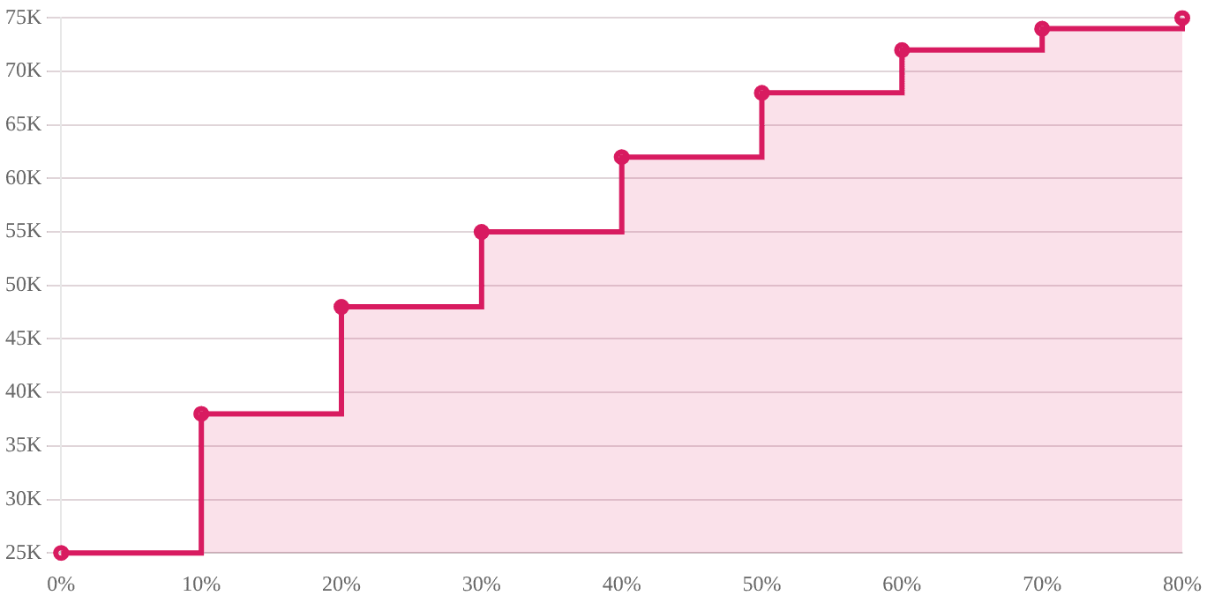
Discount is the strongest visible lever in the customer journey.
COUNT OF ID BY DISCOUNT BAND (STEPPED ANALYSIS)
Promotional Sensitivity
The marketplace reflects a high reliance on discounting to move volume, with IDs clustered in aggressive price-reduction bands.
Acquisition Momentum
Discounting remains the primary engine for customer onboarding, essential for competing in a crowded e-commerce landscape.
Retention Risk
Relying heavily on a 172.85 average discount requires a transition plan toward full-price brand loyalty to preserve long-term margins.
Marketplace Sensitivity — Dashboard Chart Analysis
Page 4

Slide 5

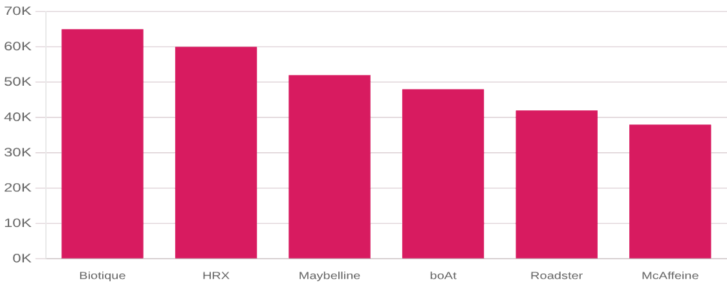
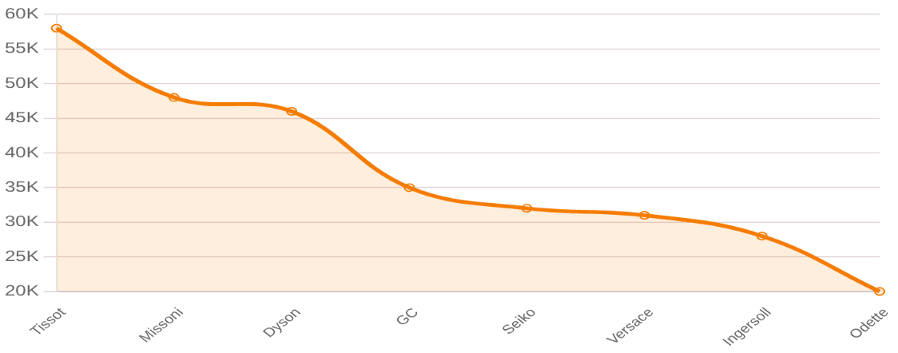
Seller performance creates a long-tail marketplace opportunity.
RATING TOTAL BY SELLER (HERO CONCENTRATION)
AVG. PRICE BY SELLER (LUXURY VS. VOLUME)
The dashboard highlights a sharp concentration of ratings in top-tier sellers like Biotique and HRX, while the price curve identifies luxury leaders (Tissot, Dyson) anchoring the premium segment. Success lies in balancing these high-margin heroes with a broad, reliable long-tail assortment.
Competitive Landscape — Dashboard Insights
Page 5

Slide 6
Myntra wins when marketplace breadth meets brand trust.
IN-HOUSE POWER
PERFORMANCE
GLOBAL RETAIL
Roadster
HRX by Hrithik
H&M
Leading the everyday-wear segment with massive volume and high rating density.
Dominating the activewear category through high-rating hero product concentration.
Anchoring the premium-fast-fashion segment with high sum-of-price inventory value.
SPORTSWEAR
ETHNIC CHIC
MARKETPLACE GOAL
Puma & Adidas
WROGN
Luxury Leaders
Driving massive ID engagement through global brand authority and discount-led velocity.
Capturing the youth-centric lifestyle market with aggressive promotional pricing.
Establishing luxury trust with Tissot and Dyson to anchor the upper-tail price spectrum.
Brand Ecosystem Strategy — Myntra Portfolio
Page 6

Slide 7

Price scale is broad while average rating remains a watchpoint.
Quality Gate Audit
OBSERVED SATISFACTION
Investigate the root cause of the 1.77 rating; focus on seller compliance, return processing, and sizing accuracy.
1.77 / 5.0
Premium Assortment Mix
Leverage the 184M price depth to transition users from low-rating discount items to high-margin, verified-quality hero brands.
OBSERVED ASSORTMENT VALUE
Review Incentivization
184M Total
Drive verified review volume to normalize the rating average and improve the confidence score for new customer IDs (5BN scale).
Quality vs. Value — Satisfaction Gap Analysis
Page 7

Slide 8
Turn dashboard signals into a customer-growth playbook.
ACQUISITION
CONVERSION
RETENTION
MIX SHIFT
Scale Optimization
Discount Precision
Rating Recovery
Price Value Depth
Leverage the 5BN ID infrastructure to hyper-personalize the top-of-funnel discount experience for new fashion segments.
Optimize the 172.85 avg discount by applying it to high-velocity sellers like HRX, while maintaining full-price luxury tiers.
Address the 1.77 rating gap through proactive customer service and AI-driven sizing recommendations to reduce returns.
Utilize the 184M inventory depth to up-sell budget customers into mid-range private labels with higher verified quality.
Strategic Growth Matrix — Execution Plan
Page 8

Slide 9
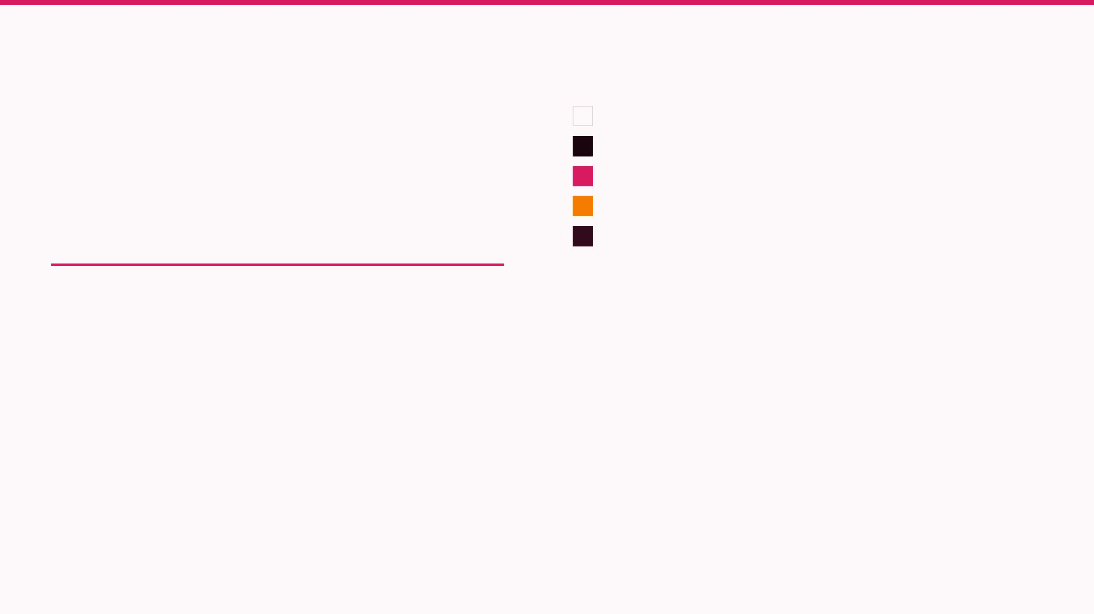
A repeatable visual system can make analytics more actionable.
Editorial Hierarchy
#FDF8F9 (Page Background)
#1A050E (Primary Typography)
Combine Playfair Display for authoritative insights and Inter for high-density data execution.
#D81B60 (KPI & Accent Focal)
#F57C00 (Secondary Data Accent)
#310A1B (Structural Headers)
ACTION-FIRST MOTIF
Every slide anchored by a functional brand rule and takeaway bullet.
Myntra Reporting Design System — V1.0
Page 9

Slide 10

Make every customer signal shoppable.
FROM 5BN IDS TO A PREMIUM MARKETPLACE EXPERIENCE.
Thank You | Myntra Customer Analysis Dashboard Story

